Slide 1

CTR PREDICTION SYSTEM
CLICK-THROUGH RATE PREDICTION SYSTEM FOR ONLINE ADVERTISEMENTS USING USER BEHAVIOR ANALYTICS
Estimate click probability, sharpen audience targeting, and turn live campaign telemetry into confident marketing decisions.
Machine Learning Architecture · Technical Readout

Slide 2




THE TARGETING PROBLEM
Online advertising needs a stronger signal
Advertisers must decide which audiences, messages, and placements deserve investment while behavior shifts across devices, cohorts, and micro-moments.
Fragmented touchpoints
Volatile contexts
Misallocated spend
Audience propensity varies by hour, screen, and creative match rather than static demographics.
Without predictive ranking, impressions flow toward passive views instead of high-intent clicks.
Signals scatter across platforms, leaving teams to guess real intent from disjointed logs.
02

Slide 3

UNIFIED PLATFORM ARCHITECTURE
The system brings fragmented signals together
A single pipeline unifies telemetry, feature engineering, and live inference into one secure, accessible interface.
Real-Time Prediction Dashboards
User Behavior Logs
Click and session histories
Live CTR forecasts
Unified CTR System
Interaction Context
Advertisement Attributes
Device, location, time
Creative and metadata
Centralized ingestion · Automated feature extraction · Role-based analytics interface
03

Slide 4



FEATURE DOMAINS
Behavior and context shape click probability
USER PROFILE
PLACEMENT CONTEXT
TEMPORAL DYNAMICS
Demographics and browsing
Device and ad category
Timing and recent interactions
Longitudinal site engagement, category affinities, and prior response history.
Screen format, operating environment, vertical taxonomy, and creative sizing.
Time of day, day-part recency, dwell duration, and immediate prior click frequency.
04

Slide 5




END-TO-END PIPELINE
From raw events to a usable prediction
Ingest interaction data
Transform features
Train classifiers
Deliver probability
Stream ad impressions, display events, and user telemetry through unified validation pipelines.
Encode interaction attributes, normalise continuous counters, and structure sparse categorical features.
Fit gradient-boosted and probabilistic classification models on historical interaction pairs.
Serve calibrated click probabilities and cohort confidence intervals directly to bidding engines.
05

Slide 6

MODELING FOUNDATION
Classification turns patterns into probabilities
Supervised algorithms evaluate historical user-ad vectors, mapping multi-dimensional interactions to a bounded probability score between 0 and 1.
INPUT VECTORS
SUPERVISED LEARNING
INFERENCE ENGINE
Contextual matching
Historical grounding
Calibrated score
Cross-references user browsing momentum against advertiser category to evaluate topical relevance before ad delivery.
Trains across verified click and non-click outcomes to penalize false positives and isolate durable engagement drivers.
Outputs a rigorous likelihood score for real-time bid pricing, audience prioritization, and creative routing.
06

Slide 7



USER INTERFACE
One interface for prediction and analysis
Secure data access
Granular reports
Actionable dashboards
Role-based permissioning, encrypted telemetry stores, and audit logs safeguarding proprietary audience data.
Probability distributions computed across bespoke audience clusters, individual campaigns, or macro segments.
Real-time performance visualisations comparing modeled click propensities against realized campaign outcomes.
07

Slide 8
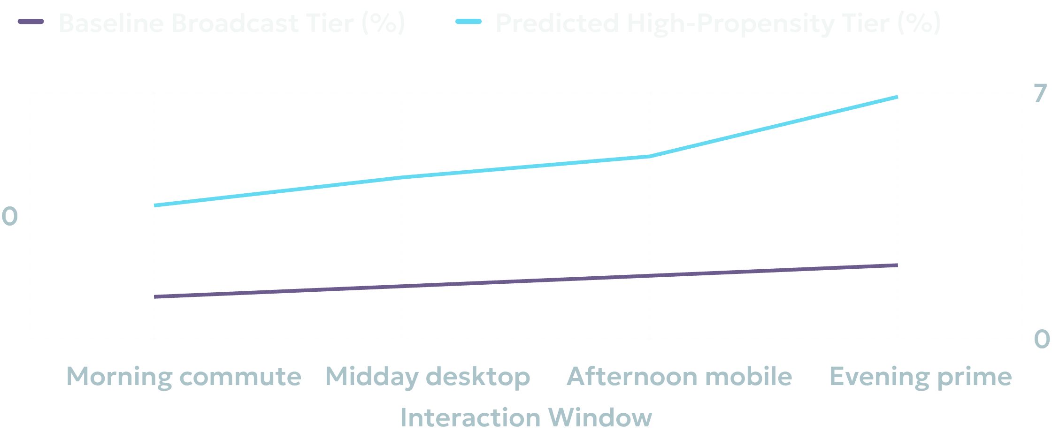
PERFORMANCE DIAGNOSTICS
Analytics reveal where performance can improve
Tracking model calibration across device tiers highlights where bids consistently out-earn baseline conversion rates.
OPTIMIZATION DELTA
3.2X
Signal separation
Targeted cohorts in peak evening windows demonstrate over 3x the responsive propensity of broad broadcast delivery.
Telemetry window analysis · Relative click likelihood across normalized cohorts
08

Slide 9
PRACTICAL IMPACT
Designed for practical marketing decisions
DECISION AREA | ANALYTICAL CAPABILITY | COMMERCIAL OUTCOME
Audience Targeting | Filter out low-propensity cohorts before auction entry | Reduce wasted impression spend across inactive profiles
Creative Strategy | Pair specific visual treatments with predicted device context | Deliver the right ad variant to the most receptive screen
Budget Allocation | Dynamic bid weighting based on estimated click rate | Maximize return on ad spend across high-probability hours
09

Slide 10

SCALE & INTEGRATION
A scalable foundation for smarter advertising
Agencies & Networks
E-Commerce & Brands
Multi-tenant reporting and real-time scoring APIs tailored for high-frequency ad exchanges.
Customer journey personalization and catalog re-targeting based on genuine purchase intent.
Enterprise Machine Learning Platform · Deployable across cloud and on-premise stacks

